Slide 1
Euclid MER VIS adaptive geometry outcomes
2,777 galaxies reprocessed
2771 disc measurements; 6 remaining failures
565 of 570 original failures recovered
Centres checked from the images. Disc and bar outcomes reported separately.
Current run 20 October 2026
1 / 17
Notes:
Sources: verified adaptive v2 MER_VIS_local_geometry_manifest.csv, MER_VIS_v2_summary.json, MER_VIS_report_verification.json. Pipeline version MER_VIS_adaptive_v2_2026-10-20 plus explicit failure-only centre recovery. Raw science images unchanged. PA is North towards East modulo180. All numbers from the current run, not copied from earlier reports.

Slide 2
Fitting outcomes by counted quality flags
Percentage of all 2,777 galaxies. Face-on is informational.
No flags: 300 (10.8%)
1 flag: 683 (24.6%)
2 flags: 842 (30.3%)
3 flags: 660 (23.8%)
4 flags: 191 (6.9%)
5 flags: 59 (2.1%)
6 flags: 30 (1.1%)
7 flags: 5 (0.2%)
8 flags: 1 (<0.1%)
Failed: 6 (0.2%)
Recovery and missing-bar warnings are counted. QI also includes partial cutout coverage.
2 / 17
Notes:
Sources: verified adaptive v2 MER_VIS_local_geometry_manifest.csv, MER_VIS_v2_summary.json, MER_VIS_report_verification.json. Pipeline version MER_VIS_adaptive_v2_2026-10-20 plus explicit failure-only centre recovery. Raw science images unchanged. PA is North towards East modulo180. All numbers from the current run, not copied from earlier reports.

Slide 3
Current quality issues and information
59 nearly face-on fits: informational, not a defect. Disc PA instability is ignored for them.
3 / 17
Notes:
Sources: verified adaptive v2 MER_VIS_local_geometry_manifest.csv, MER_VIS_v2_summary.json, MER_VIS_report_verification.json. Pipeline version MER_VIS_adaptive_v2_2026-10-20 plus explicit failure-only centre recovery. Raw science images unchanged. PA is North towards East modulo180. All numbers from the current run, not copied from earlier reports. Flags overlap. Chart shows the eleven most frequent issues; the Word report and manifest retain every flag. A no_bar_detected warning does not invalidate the disc estimate. Individual PA scatter is not a formal independent uncertainty.

Slide 4
Comparison with Euclid and supplied geometry
Median absolute difference | Current run
Adjusted Euclid detection PA | 8.05°
Detection inclination proxy | 6.52°
Sérsic inclination proxy | 5.50°
Codex PA: North towards East. N = 0°, E = 90°, modulo 180°.
Counterclockwise on a North-up, East-left image. WCS handles local orientation.
Euclid comparison retains the adopted additional +90° after WCS conversion. A detection-image y-axis reference is plausible but unconfirmed.
4 / 17
Notes:
Sources: verified adaptive v2 MER_VIS_local_geometry_manifest.csv, MER_VIS_v2_summary.json, MER_VIS_report_verification.json. Pipeline version MER_VIS_adaptive_v2_2026-10-20 plus explicit failure-only centre recovery. Raw science images unchanged. PA is North towards East modulo180. All numbers from the current run, not copied from earlier reports. Supplied fitted-manifest comparison: {"disc":{"n":2771,"median_abs":2.7634391474113187,"median_signed":0.021808524369362203,"within10":2167},"bar":{"n":2290,"median_abs":0.4527846299673044,"median_signed":-0.0035939381289082917,"within10":2235},"inclination":{"n":2771,"median_abs":2.3744889759578527,"median_signed":-0.9662639215711621,"within10":2427}}. Supplied inclination uses intrinsic q0=.2; ours remains q0=0. Euclid whole-object shapes are proxies, not independent outer-disc measurements. No Euclid bar PA is available.

Slide 5
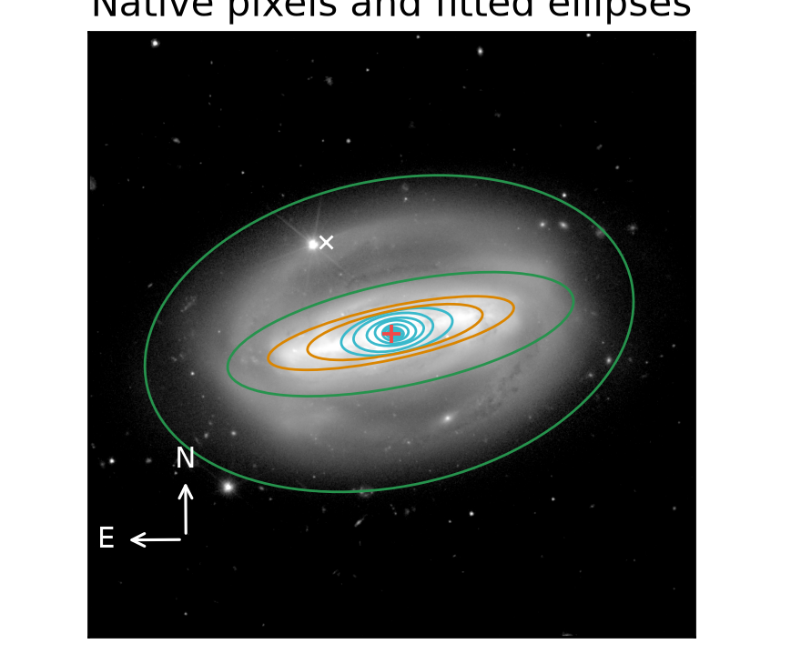
Galaxy centres are measured and checked
A catalogue position can lie on off-centre light rather than the galaxy centre.
White x: catalogue position.
Red +: fitted disc centre.
This example: 17.32 arcsec shift.
Sample median: 0.083 arcsec.
Large offsets and centre changes across radius remain flagged for review. The catalogue and fitted positions are both retained.
Synthetic check recovered the known centre within 0.01 pixel and PA/inclination within 0.01°.
5 / 17
Notes:
Sources: verified adaptive v2 MER_VIS_local_geometry_manifest.csv, MER_VIS_v2_summary.json, MER_VIS_report_verification.json. Pipeline version MER_VIS_adaptive_v2_2026-10-20 plus explicit failure-only centre recovery. Raw science images unchanged. PA is North towards East modulo180. All numbers from the current run, not copied from earlier reports. Centre example (multiple flags, not an isolated-flag demonstration): {"id":"2700376345666189458","image":"C:\\Users\\gordo\\Documents\\Github\\PythonScripts\\Foreground Masking\\MER_VIS_pipeline_v2\\current_report\\images\\2700376345666189458.png","full_card":"D:\\Dropbox\\Public Documents\\UCLAN\\MSc Research\\Euclid\\MER_VIS_galaxy_reports\\all_2777\\png_QI\\2448_Euclid_2700376345666189458_MER_VIS_geometry_report_QI.png","disc":101.52336049391899,"bar":101.48498053450594,"inc":71.05369315170853,"centre_offset":17.320432011634527,"method":"recentred","flags":["centre_offset_large","disc_axis_ratio_unstable"],"bar_status":"detected_A","error":"","n_good":"43","n_disc":"5","n_bar":"4","disc_scatter":0.9310092684915722,"disc_span":0.3545431996625442,"bar_end":19.181222769615243,"information":"","detail_image":"C:\\Users\\gordo\\Documents\\Github\\PythonScripts\\Foreground Masking\\MER_VIS_pipeline_v2\\current_report\\images\\centre_detail.png"}

Slide 6
Updated review collection
Review group | PNG reports
QI | 2491
NoQI | 286
Total | 2777
47 PDFs; 464 pages; six galaxies per page.
Each card includes selected ellipses, profiles, angles, Euclid deltas, centre offset and recovery method. No accepted bar leaves bar PA blank.
Next slides use current examples. Recovery warnings may co-occur; isolated examples are shown only where available.
6 / 17
Notes:
Sources: verified adaptive v2 MER_VIS_local_geometry_manifest.csv, MER_VIS_v2_summary.json, MER_VIS_report_verification.json. Pipeline version MER_VIS_adaptive_v2_2026-10-20 plus explicit failure-only centre recovery. Raw science images unchanged. PA is North towards East modulo180. All numbers from the current run, not copied from earlier reports. Isolated example counts (full coverage): {"disc_PA_unstable":89,"no_bar_detected":101,"disc_axis_ratio_unstable":109,"small_bar_sensitive_to_resolution":316,"disc_range_fallback":1,"bar_disc_ranges_close":0,"small_disc":0,"weak_ellipse_bar_signature":37,"centre_offset_large":3,"relaxed_fit":0,"iteration_limited_samples":0,"star_mask_removed":0,"centre_unstable":0,"short_accepted_profile":0,"high_inclination":0}. Flags without two isolated cases are not represented as single-flag examples. Original unstable-bar-PA examples are obsolete because current bar acceptance requires a stable plateau.

Slide 7
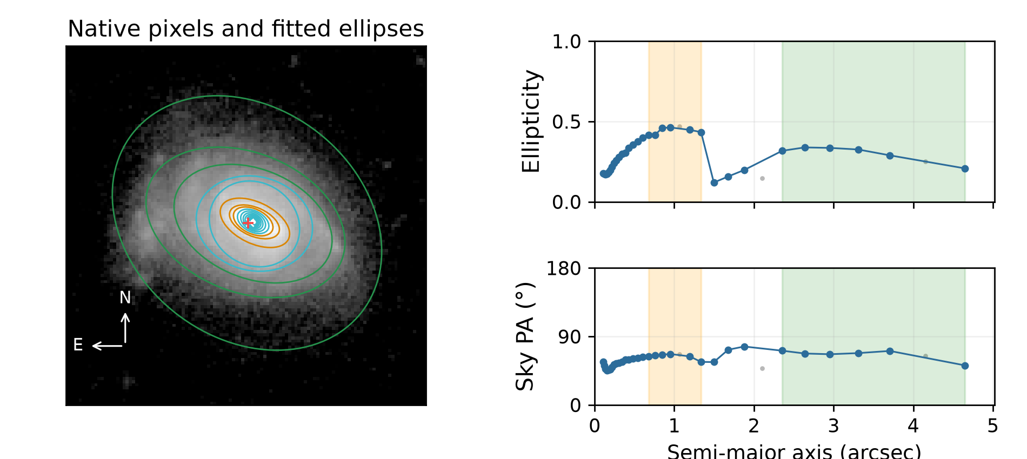
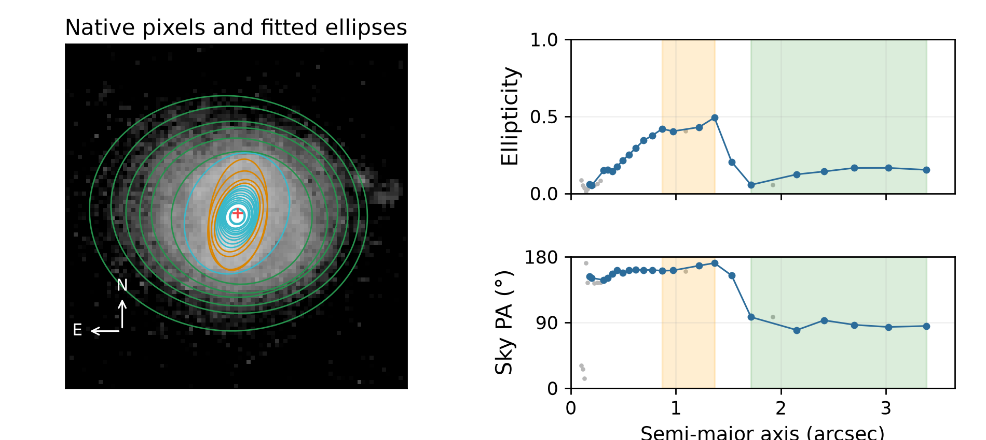
Small selected bar interval
Exactly one counted quality flag in each example; full cutout coverage.
Galaxy -518659917291205827
Galaxy -518003489287870292
Disc 67.98°; bar 63.85°; i 47.29°
Centre offset 0.07 arcsec; 31 accepted ellipses.
Disc 87.46°; bar 167.23°; i 31.57°
Centre offset 0.04 arcsec; 22 accepted ellipses.
316 isolated cases available. Orange: selected bar. Green: selected disc. Blue: accepted samples. Grey: rejected samples.
7 / 17
Notes:
Sources: verified adaptive v2 MER_VIS_local_geometry_manifest.csv, MER_VIS_v2_summary.json, MER_VIS_report_verification.json. Pipeline version MER_VIS_adaptive_v2_2026-10-20 plus explicit failure-only centre recovery. Raw science images unchanged. PA is North towards East modulo180. All numbers from the current run, not copied from earlier reports. Example records: {"key":"small_bar_sensitive_to_resolution","title":"Small selected bar interval","kind":"isolated_flag","examples":[{"id":"-518659917291205827","image":"C:\\Users\\gordo\\Documents\\Github\\PythonScripts\\Foreground Masking\\MER_VIS_pipeline_v2\\current_report\\images\\-518659917291205827.png","full_card":"D:\\Dropbox\\Public Documents\\UCLAN\\MSc Research\\Euclid\\MER_VIS_galaxy_reports\\all_2777\\png_QI\\0004_Euclid_-518659917291205827_MER_VIS_geometry_report_QI.png","disc":67.98049109589249,"bar":63.85453266313511,"inc":47.29360925833979,"centre_offset":0.06901554767367604,"method":"standard","flags":["small_bar_sensitive_to_resolution"],"bar_status":"detected_A","error":"","n_good":"31","n_disc":"6","n_bar":"6","disc_scatter":6.536223807890531,"disc_span":0.1305755018371826,"bar_end":1.3365451794213465,"information":""},{"id":"-518003489287870292","image":"C:\\Users\\gordo\\Documents\\Github\\PythonScripts\\Foreground Masking\\MER_VIS_pipeline_v2\\current_report\\images\\-518003489287870292.png","full_card":"D:\\Dropbox\\Public Documents\\UCLAN\\MSc Research\\Euclid\\MER_VIS_galaxy_reports\\all_2777\\png_QI\\0007_Euclid_-518003489287870292_MER_VIS_geometry_report_QI.png","disc":87.46210239608925,"bar":167.22729398125324,"inc":31.574961051993903,"centre_offset":0.043422001129307254,"method":"standard","flags":["small_bar_sensitive_to_resolution"],"bar_status":"detected_A","error":"","n_good":"22","n_disc":"6","n_bar":"4","disc_scatter":5.924727031910115,"disc_span":0.11007119226523457,"bar_end":1.3673627605688643,"information":""}],"available":316}

Slide 8
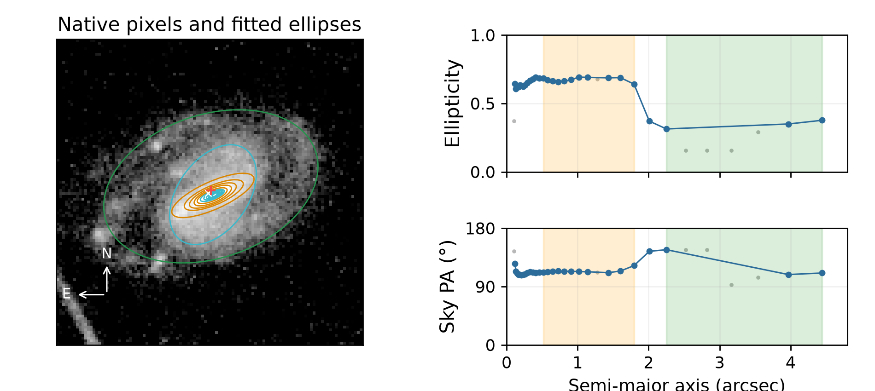
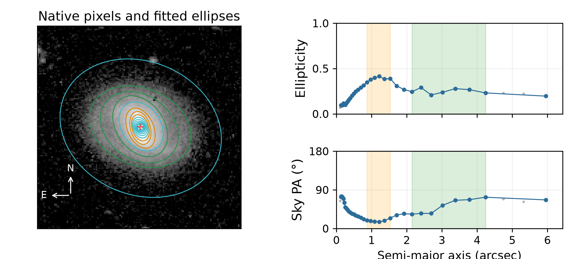
Unstable disc PA
Exactly one counted quality flag in each example; full cutout coverage.
Galaxy -518633776290631360
Galaxy -601121275504424227
Disc 113.69°; bar 113.87°; i 49.48°
Centre offset 0.15 arcsec; 28 accepted ellipses.
Disc 60.75°; bar 20.23°; i 40.93°
Centre offset 0.04 arcsec; 33 accepted ellipses.
89 isolated cases available. Orange: selected bar. Green: selected disc. Blue: accepted samples. Grey: rejected samples.
8 / 17
Notes:
Sources: verified adaptive v2 MER_VIS_local_geometry_manifest.csv, MER_VIS_v2_summary.json, MER_VIS_report_verification.json. Pipeline version MER_VIS_adaptive_v2_2026-10-20 plus explicit failure-only centre recovery. Raw science images unchanged. PA is North towards East modulo180. All numbers from the current run, not copied from earlier reports. Example records: {"key":"disc_PA_unstable","title":"Unstable disc PA","kind":"isolated_flag","examples":[{"id":"-518633776290631360","image":"C:\\Users\\gordo\\Documents\\Github\\PythonScripts\\Foreground Masking\\MER_VIS_pipeline_v2\\current_report\\images\\-518633776290631360.png","full_card":"D:\\Dropbox\\Public Documents\\UCLAN\\MSc Research\\Euclid\\MER_VIS_galaxy_reports\\all_2777\\png_QI\\0005_Euclid_-518633776290631360_MER_VIS_geometry_report_QI.png","disc":113.69021016263804,"bar":113.86950382756103,"inc":49.47781434213959,"centre_offset":0.15091616609311526,"method":"standard","flags":["disc_PA_unstable"],"bar_status":"detected_A","error":"","n_good":"28","n_disc":"3","n_bar":"11","disc_scatter":17.55097022310975,"disc_span":0.06326608973174502,"bar_end":1.7950070214699363,"information":""},{"id":"-601121275504424227","image":"C:\\Users\\gordo\\Documents\\Github\\PythonScripts\\Foreground Masking\\MER_VIS_pipeline_v2\\current_report\\images\\-601121275504424227.png","full_card":"D:\\Dropbox\\Public Documents\\UCLAN\\MSc Research\\Euclid\\MER_VIS_galaxy_reports\\all_2777\\png_QI\\0118_Euclid_-601121275504424227_MER_VIS_geometry_report_QI.png","disc":60.75482419435342,"bar":20.23373226136634,"inc":40.93111225561656,"centre_offset":0.038965526533334946,"method":"standard","flags":["disc_PA_unstable"],"bar_status":"detected_A","error":"","n_good":"33","n_disc":"7","n_bar":"6","disc_scatter":15.878385450188937,"disc_span":0.08169376743863846,"bar_end":1.5289036078363487,"information":""}],"available":89}

Slide 9
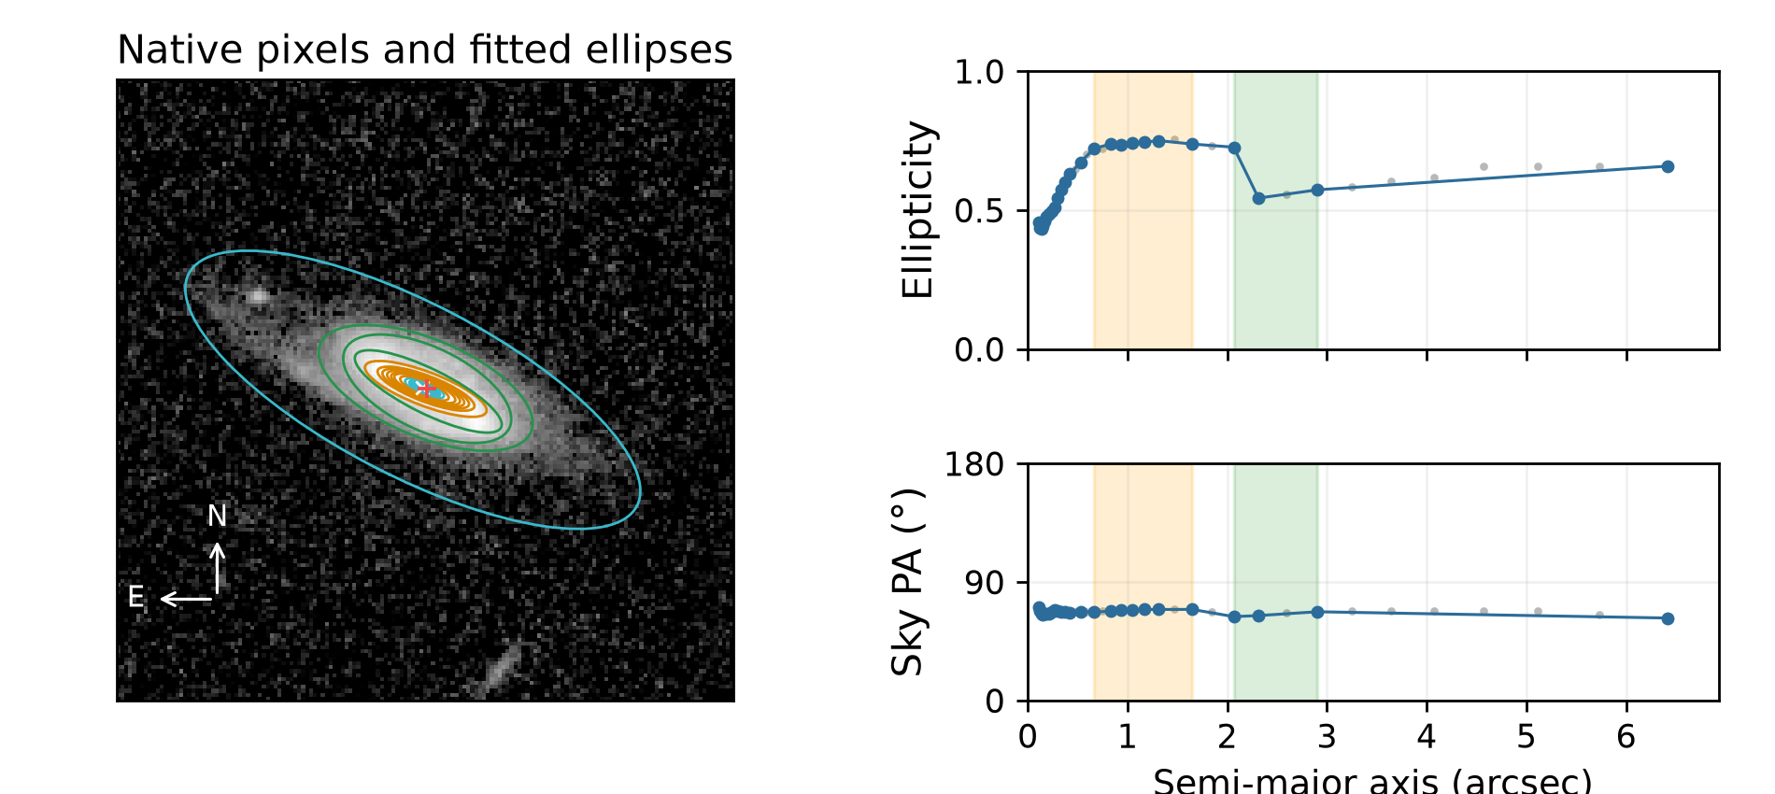
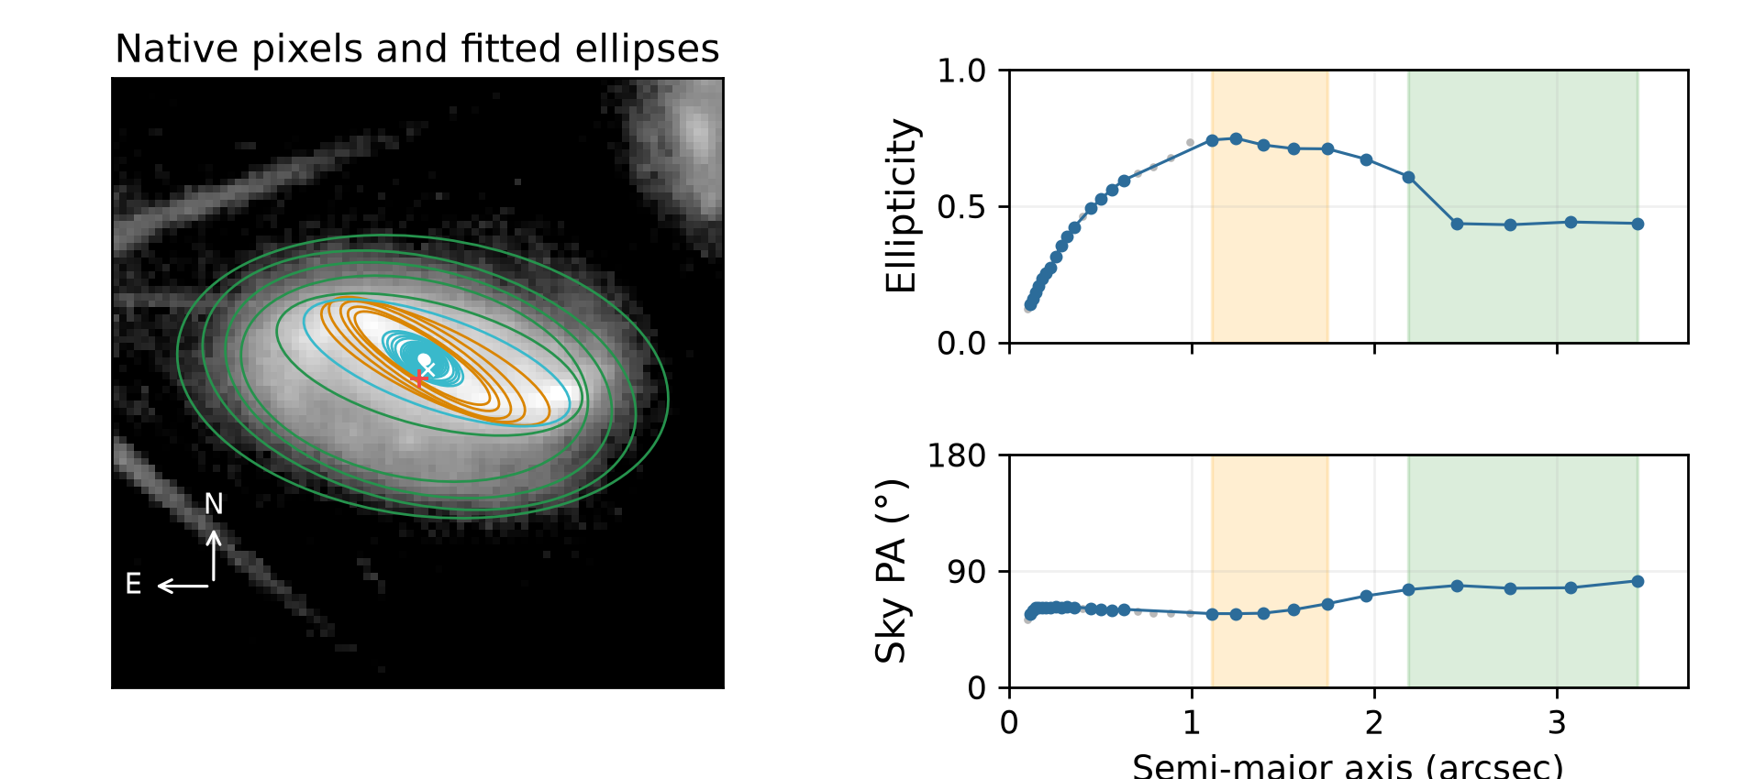
Changing disc ellipticity
Exactly one counted quality flag in each example; full cutout coverage.
Galaxy -515262325287813002
Galaxy 2696479031648186651
Disc 66.04°; bar 68.86°; i 64.73°
Centre offset 0.14 arcsec; 25 accepted ellipses.
Disc 77.11°; bar 59.69°; i 55.74°
Centre offset 0.17 arcsec; 26 accepted ellipses.
109 isolated cases available. Orange: selected bar. Green: selected disc. Blue: accepted samples. Grey: rejected samples.
9 / 17
Notes:
Sources: verified adaptive v2 MER_VIS_local_geometry_manifest.csv, MER_VIS_v2_summary.json, MER_VIS_report_verification.json. Pipeline version MER_VIS_adaptive_v2_2026-10-20 plus explicit failure-only centre recovery. Raw science images unchanged. PA is North towards East modulo180. All numbers from the current run, not copied from earlier reports. Example records: {"key":"disc_axis_ratio_unstable","title":"Changing disc ellipticity","kind":"isolated_flag","examples":[{"id":"-515262325287813002","image":"C:\\Users\\gordo\\Documents\\Github\\PythonScripts\\Foreground Masking\\MER_VIS_pipeline_v2\\current_report\\images\\-515262325287813002.png","full_card":"D:\\Dropbox\\Public Documents\\UCLAN\\MSc Research\\Euclid\\MER_VIS_galaxy_reports\\all_2777\\png_QI\\0011_Euclid_-515262325287813002_MER_VIS_geometry_report_QI.png","disc":66.03707596640753,"bar":68.85970901634602,"inc":64.73095080753262,"centre_offset":0.1353995530576807,"method":"standard","flags":["disc_axis_ratio_unstable"],"bar_status":"detected_A","error":"","n_good":"25","n_disc":"3","n_bar":"7","disc_scatter":1.590904046671006,"disc_span":0.18310711393429147,"bar_end":1.647470680939178,"information":""},{"id":"2696479031648186651","image":"C:\\Users\\gordo\\Documents\\Github\\PythonScripts\\Foreground Masking\\MER_VIS_pipeline_v2\\current_report\\images\\2696479031648186651.png","full_card":"D:\\Dropbox\\Public Documents\\UCLAN\\MSc Research\\Euclid\\MER_VIS_galaxy_reports\\all_2777\\png_QI\\0032_Euclid_2696479031648186651_MER_VIS_geometry_report_QI.png","disc":77.10657289201272,"bar":59.69115649098335,"inc":55.741582582526576,"centre_offset":0.1684548011078397,"method":"standard","flags":["disc_axis_ratio_unstable"],"bar_status":"detected_A","error":"","n_good":"26","n_disc":"5","n_bar":"5","disc_scatter":2.3970908949172394,"disc_span":0.17713086931805122,"bar_end":1.743747455273023,"information":""}],"available":109}

Slide 10
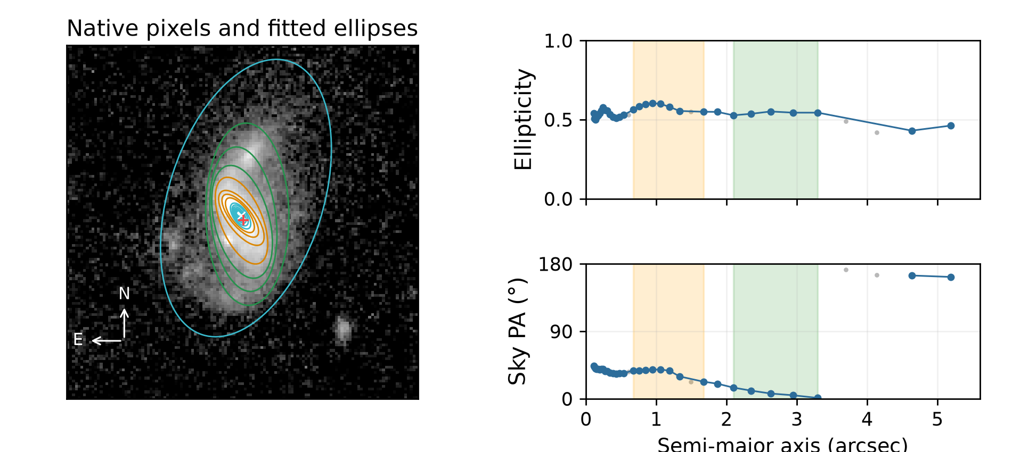
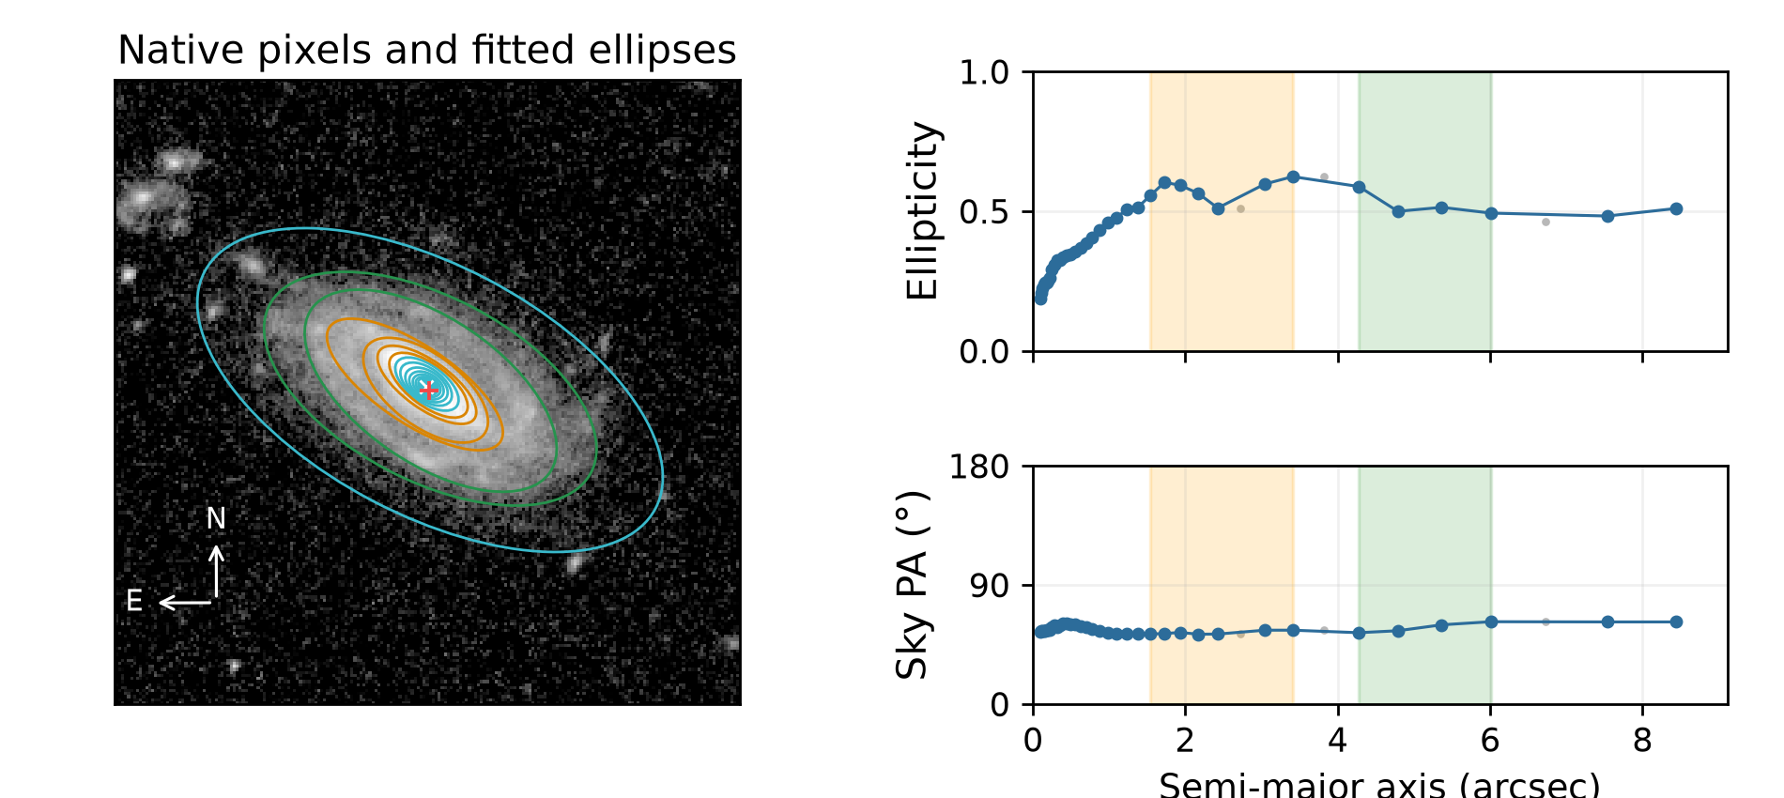
Weaker accepted bar signature
Exactly one counted quality flag in each example; full cutout coverage.
Galaxy -586037871514112362
Galaxy -593494399504450575
Disc 9.11°; bar 34.11°; i 62.89°
Centre offset 0.20 arcsec; 31 accepted ellipses.
Disc 56.81°; bar 53.95°; i 60.45°
Centre offset 0.14 arcsec; 37 accepted ellipses.
37 isolated cases available. Orange: selected bar. Green: selected disc. Blue: accepted samples. Grey: rejected samples.
10 / 17
Notes:
Sources: verified adaptive v2 MER_VIS_local_geometry_manifest.csv, MER_VIS_v2_summary.json, MER_VIS_report_verification.json. Pipeline version MER_VIS_adaptive_v2_2026-10-20 plus explicit failure-only centre recovery. Raw science images unchanged. PA is North towards East modulo180. All numbers from the current run, not copied from earlier reports. Example records: {"key":"weak_ellipse_bar_signature","title":"Weaker accepted bar signature","kind":"isolated_flag","examples":[{"id":"-586037871514112362","image":"C:\\Users\\gordo\\Documents\\Github\\PythonScripts\\Foreground Masking\\MER_VIS_pipeline_v2\\current_report\\images\\-586037871514112362.png","full_card":"D:\\Dropbox\\Public Documents\\UCLAN\\MSc Research\\Euclid\\MER_VIS_galaxy_reports\\all_2777\\png_QI\\0038_Euclid_-586037871514112362_MER_VIS_geometry_report_QI.png","disc":9.105889954495566,"bar":34.111648931941794,"inc":62.88522648383609,"centre_offset":0.1989049028260931,"method":"standard","flags":["weak_ellipse_bar_signature"],"bar_status":"detected_B","error":"","n_good":"31","n_disc":"5","n_bar":"8","disc_scatter":4.80374870233757,"disc_span":0.02419444275218674,"bar_end":1.671515786936715,"information":""},{"id":"-593494399504450575","image":"C:\\Users\\gordo\\Documents\\Github\\PythonScripts\\Foreground Masking\\MER_VIS_pipeline_v2\\current_report\\images\\-593494399504450575.png","full_card":"D:\\Dropbox\\Public Documents\\UCLAN\\MSc Research\\Euclid\\MER_VIS_galaxy_reports\\all_2777\\png_QI\\0106_Euclid_-593494399504450575_MER_VIS_geometry_report_QI.png","disc":56.81140276193682,"bar":53.95386470424249,"inc":60.45276653085282,"centre_offset":0.13845623690753606,"method":"standard","flags":["weak_ellipse_bar_signature"],"bar_status":"detected_B","error":"","n_good":"37","n_disc":"4","n_bar":"7","disc_scatter":3.3408151732091875,"disc_span":0.09514957428153942,"bar_end":3.4097589372753903,"information":""}],"available":37}

Slide 11
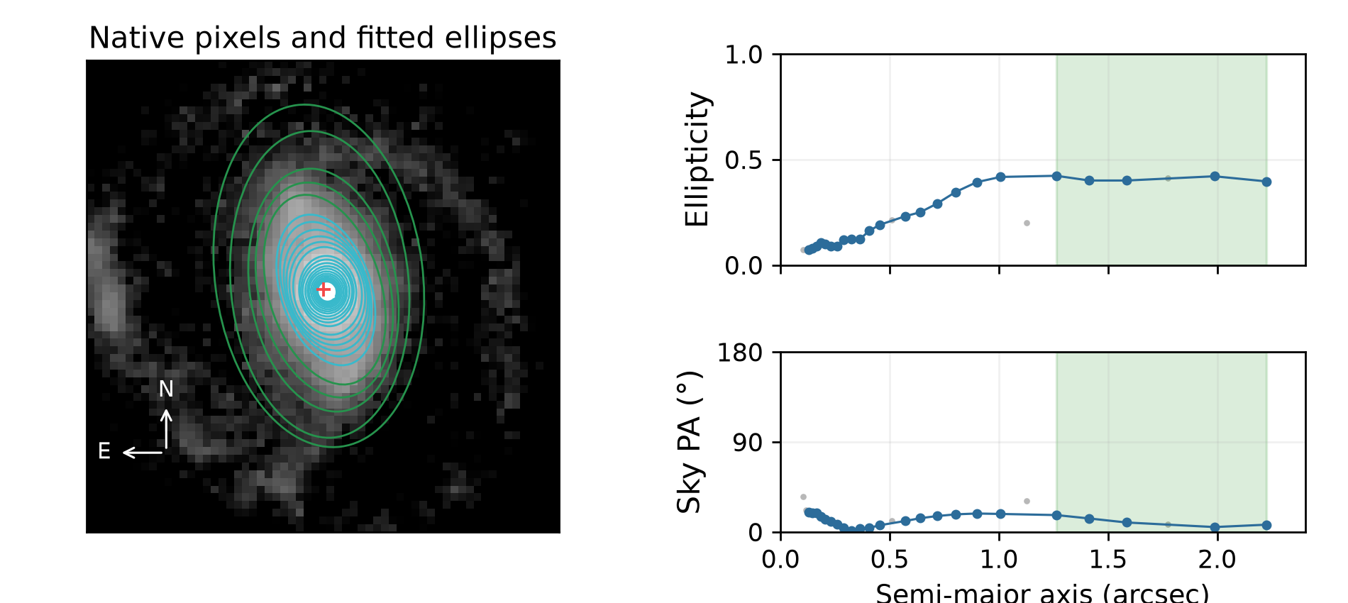
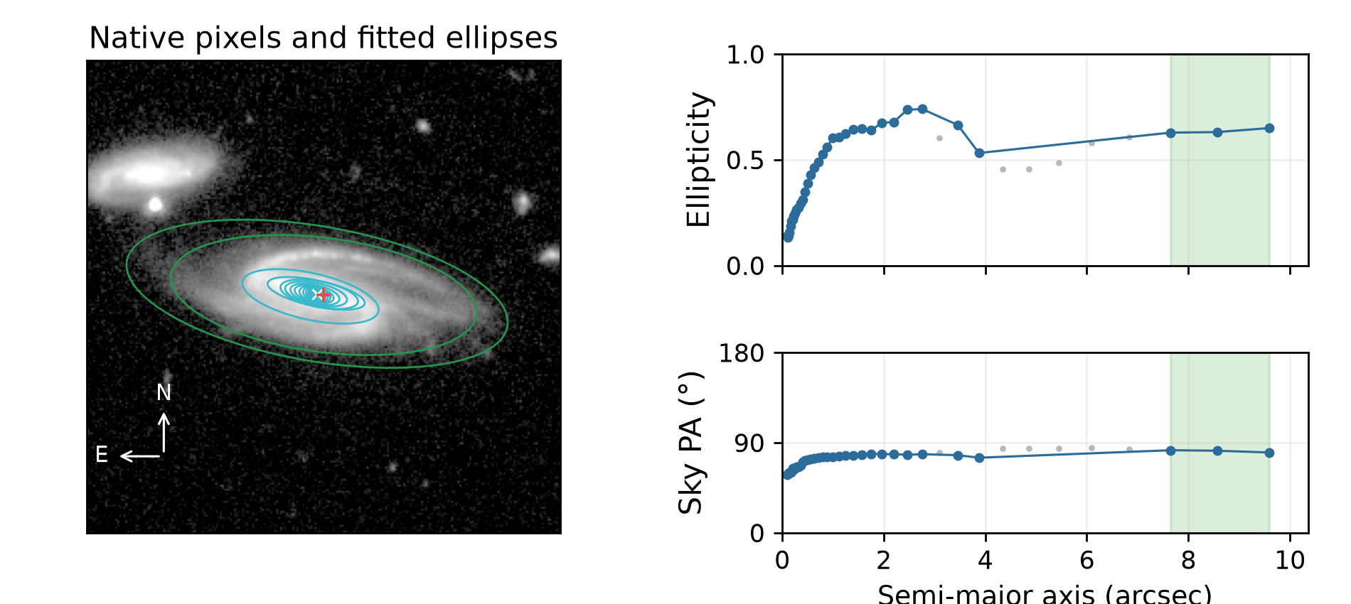
No accepted bar; disc retained
Exactly one counted quality flag in each example; full cutout coverage.
Galaxy -550331516283529196
Galaxy -547491640287288205
Disc 13.45°; bar unavailable; i 53.20°
Centre offset 0.08 arcsec; 23 accepted ellipses.
Disc 82.00°; bar unavailable; i 68.38°
Centre offset 0.34 arcsec; 35 accepted ellipses.
101 isolated cases available. Orange: selected bar. Green: selected disc. Blue: accepted samples. Grey: rejected samples.
11 / 17
Notes:
Sources: verified adaptive v2 MER_VIS_local_geometry_manifest.csv, MER_VIS_v2_summary.json, MER_VIS_report_verification.json. Pipeline version MER_VIS_adaptive_v2_2026-10-20 plus explicit failure-only centre recovery. Raw science images unchanged. PA is North towards East modulo180. All numbers from the current run, not copied from earlier reports. Example records: {"key":"no_bar_detected","title":"No accepted bar; disc retained","kind":"isolated_flag","examples":[{"id":"-550331516283529196","image":"C:\\Users\\gordo\\Documents\\Github\\PythonScripts\\Foreground Masking\\MER_VIS_pipeline_v2\\current_report\\images\\-550331516283529196.png","full_card":"D:\\Dropbox\\Public Documents\\UCLAN\\MSc Research\\Euclid\\MER_VIS_galaxy_reports\\all_2777\\png_QI\\0015_Euclid_-550331516283529196_MER_VIS_geometry_report_QI.png","disc":13.449994139974416,"bar":null,"inc":53.200259774137066,"centre_offset":0.08195275586604336,"method":"standard","flags":["no_bar_detected"],"bar_status":"no_bar_detected","error":"","n_good":"23","n_disc":"5","n_bar":"","disc_scatter":4.29853966960997,"disc_span":0.026672529924157418,"bar_end":null,"information":""},{"id":"-547491640287288205","image":"C:\\Users\\gordo\\Documents\\Github\\PythonScripts\\Foreground Masking\\MER_VIS_pipeline_v2\\current_report\\images\\-547491640287288205.png","full_card":"D:\\Dropbox\\Public Documents\\UCLAN\\MSc Research\\Euclid\\MER_VIS_galaxy_reports\\all_2777\\png_QI\\0024_Euclid_-547491640287288205_MER_VIS_geometry_report_QI.png","disc":82.0014985516179,"bar":null,"inc":68.37738067314605,"centre_offset":0.34474729988990355,"method":"standard","flags":["no_bar_detected"],"bar_status":"no_bar_detected","error":"","n_good":"35","n_disc":"3","n_bar":"","disc_scatter":0.9701814169712194,"disc_span":0.021516770074129,"bar_end":null,"information":""}],"available":101}

Slide 12
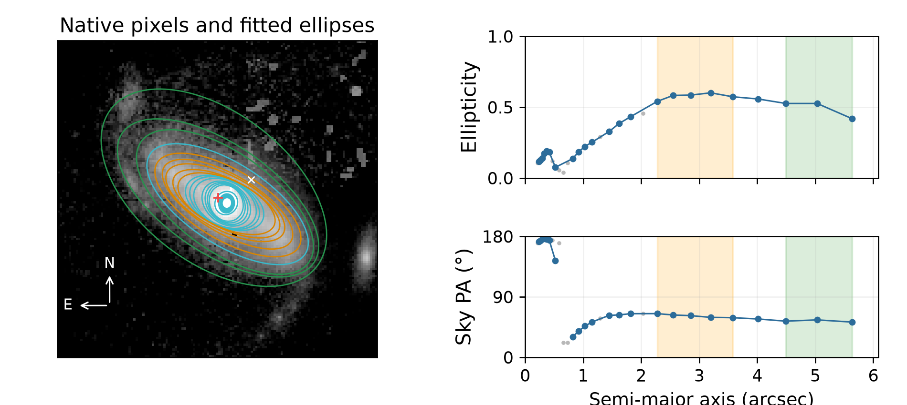
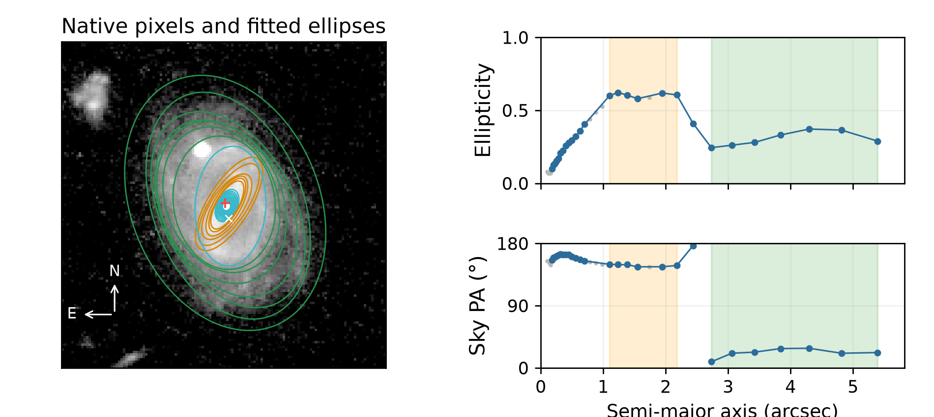
Large centre offset
Exactly one counted quality flag in each example; full cutout coverage.
Galaxy -596168966496153208
Galaxy -647912843459445604
Disc 54.40°; bar 60.50°; i 61.73°
Centre offset 1.65 arcsec; 23 accepted ellipses.
Disc 24.55°; bar 147.96°; i 44.73°
Centre offset 0.65 arcsec; 27 accepted ellipses.
3 isolated cases available. Orange: selected bar. Green: selected disc. Blue: accepted samples. Grey: rejected samples.
12 / 17
Notes:
Sources: verified adaptive v2 MER_VIS_local_geometry_manifest.csv, MER_VIS_v2_summary.json, MER_VIS_report_verification.json. Pipeline version MER_VIS_adaptive_v2_2026-10-20 plus explicit failure-only centre recovery. Raw science images unchanged. PA is North towards East modulo180. All numbers from the current run, not copied from earlier reports. Example records: {"key":"centre_offset_large","title":"Large centre offset","kind":"isolated_flag","examples":[{"id":"-596168966496153208","image":"C:\\Users\\gordo\\Documents\\Github\\PythonScripts\\Foreground Masking\\MER_VIS_pipeline_v2\\current_report\\images\\-596168966496153208.png","full_card":"D:\\Dropbox\\Public Documents\\UCLAN\\MSc Research\\Euclid\\MER_VIS_galaxy_reports\\all_2777\\png_QI\\0311_Euclid_-596168966496153208_MER_VIS_geometry_report_QI.png","disc":54.40104215802481,"bar":60.50292653034644,"inc":61.726307068838516,"centre_offset":1.649476936680464,"method":"standard","flags":["centre_offset_large"],"bar_status":"detected_A","error":"","n_good":"23","n_disc":"3","n_bar":"5","disc_scatter":1.3369802520127432,"disc_span":0.10756910840763029,"bar_end":3.5816608240191705,"information":""},{"id":"-647912843459445604","image":"C:\\Users\\gordo\\Documents\\Github\\PythonScripts\\Foreground Masking\\MER_VIS_pipeline_v2\\current_report\\images\\-647912843459445604.png","full_card":"D:\\Dropbox\\Public Documents\\UCLAN\\MSc Research\\Euclid\\MER_VIS_galaxy_reports\\all_2777\\png_QI\\1337_Euclid_-647912843459445604_MER_VIS_geometry_report_QI.png","disc":24.55400035808897,"bar":147.96450249863796,"inc":44.733672141806856,"centre_offset":0.6455756763639631,"method":"standard","flags":["centre_offset_large"],"bar_status":"detected_A","error":"","n_good":"27","n_disc":"7","n_bar":"6","disc_scatter":5.982459011560956,"disc_span":0.12758824839973812,"bar_end":2.1784393142233225,"information":""}],"available":3}

Slide 13
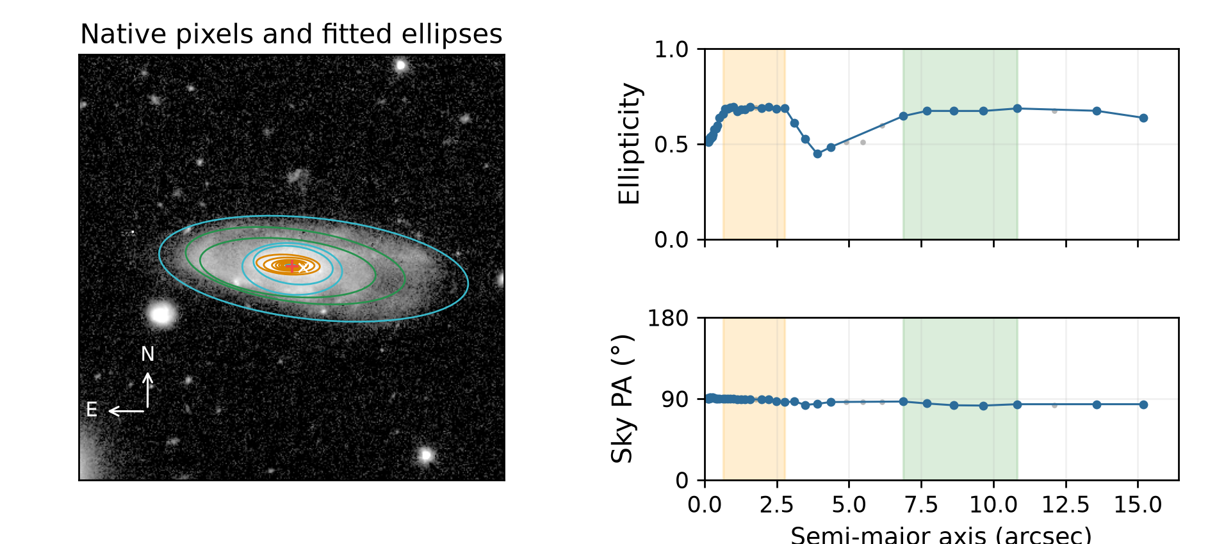
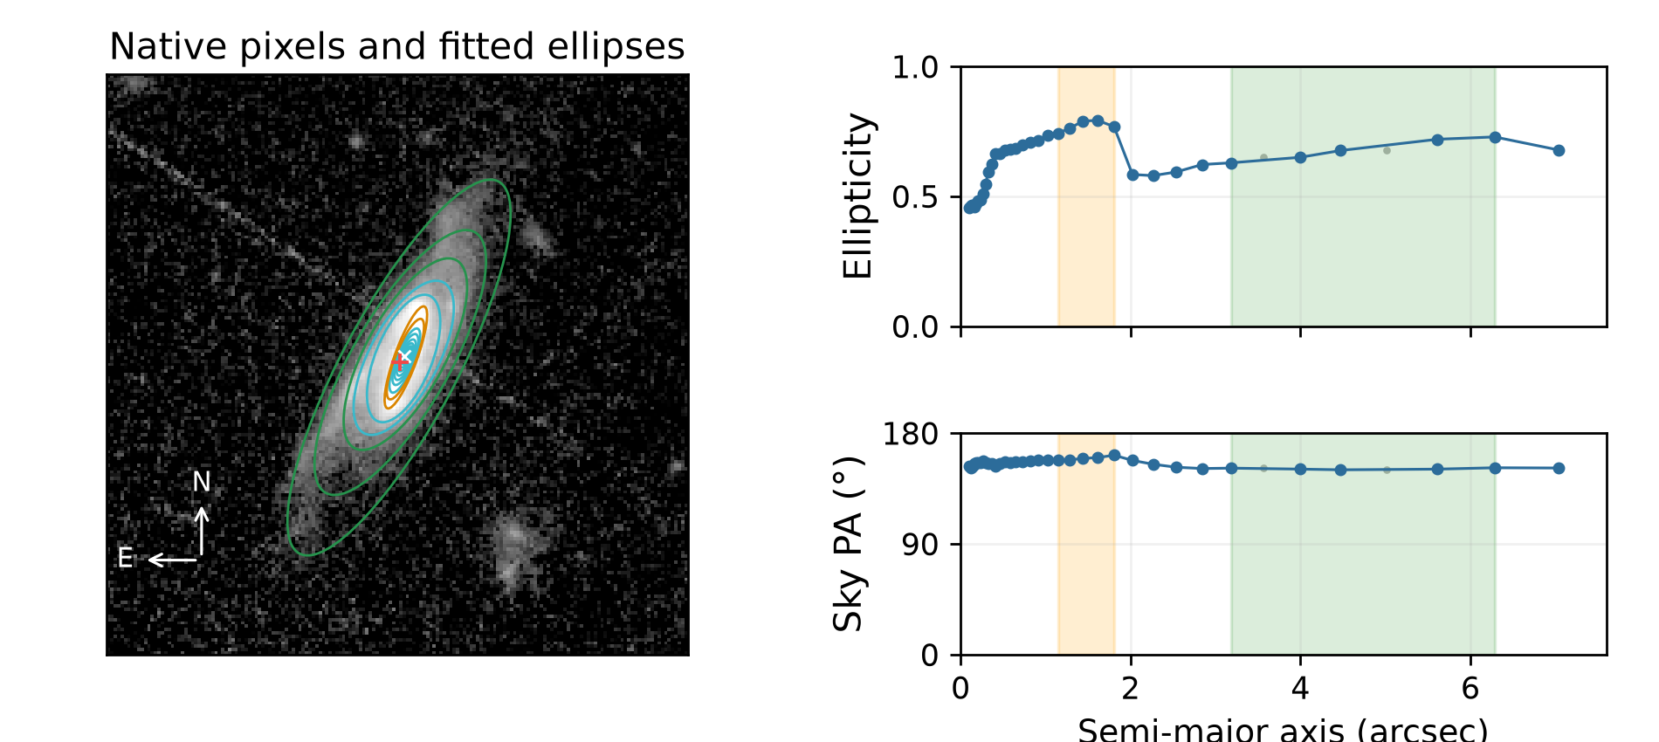
Recovered interval failures
These galaxies previously failed; the current pipeline returns provisional geometry.
Galaxy -637379992495894829
Galaxy 2660732568647808880
Disc 83.79°; bar 88.98°; i 70.95°
Centre offset 0.96 arcsec; 38 accepted ellipses.
Disc 151.04°; bar 159.58°; i 71.14°
Centre offset 0.21 arcsec; 36 accepted ellipses.
Recovery does not imply an unflagged result. Inspect the selected intervals, centre and method.
13 / 17
Notes:
Sources: verified adaptive v2 MER_VIS_local_geometry_manifest.csv, MER_VIS_v2_summary.json, MER_VIS_report_verification.json. Pipeline version MER_VIS_adaptive_v2_2026-10-20 plus explicit failure-only centre recovery. Raw science images unchanged. PA is North towards East modulo180. All numbers from the current run, not copied from earlier reports. Example records: {"key":"Insufficient bar/disc","title":"Recovered interval failures","kind":"recovery","examples":[{"id":"-637379992495894829","image":"C:\\Users\\gordo\\Documents\\Github\\PythonScripts\\Foreground Masking\\MER_VIS_pipeline_v2\\current_report\\images\\-637379992495894829.png","full_card":"D:\\Dropbox\\Public Documents\\UCLAN\\MSc Research\\Euclid\\MER_VIS_galaxy_reports\\all_2777\\png_NoQI\\0388_Euclid_-637379992495894829_MER_VIS_geometry_report.png","disc":83.78837749362367,"bar":88.98374946530096,"inc":70.94767990401837,"centre_offset":0.9601168086879205,"method":"standard","flags":[],"bar_status":"detected_A","error":"","n_good":"38","n_disc":"5","n_bar":"13","disc_scatter":1.6022783154287463,"disc_span":0.040266137755290754,"bar_end":2.7760226627438467,"information":""},{"id":"2660732568647808880","image":"C:\\Users\\gordo\\Documents\\Github\\PythonScripts\\Foreground Masking\\MER_VIS_pipeline_v2\\current_report\\images\\2660732568647808880.png","full_card":"D:\\Dropbox\\Public Documents\\UCLAN\\MSc Research\\Euclid\\MER_VIS_galaxy_reports\\all_2777\\png_NoQI\\2092_Euclid_2660732568647808880_MER_VIS_geometry_report.png","disc":151.03655359834403,"bar":159.57881576983513,"inc":71.14166107576276,"centre_offset":0.2073528623875833,"method":"standard","flags":[],"bar_status":"detected_A","error":"","n_good":"36","n_disc":"5","n_bar":"5","disc_scatter":0.6028207774305036,"disc_span":0.09974640817899039,"bar_end":1.8072562617551795,"information":""}],"available":430}

Slide 14
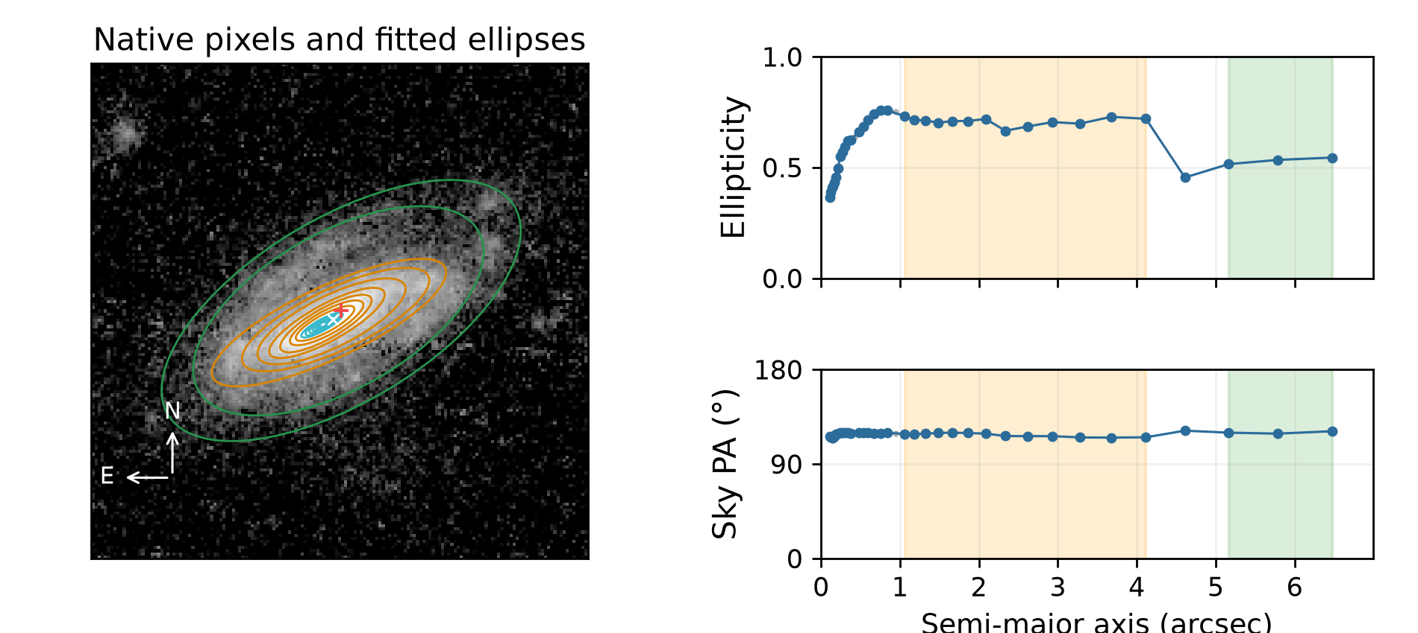
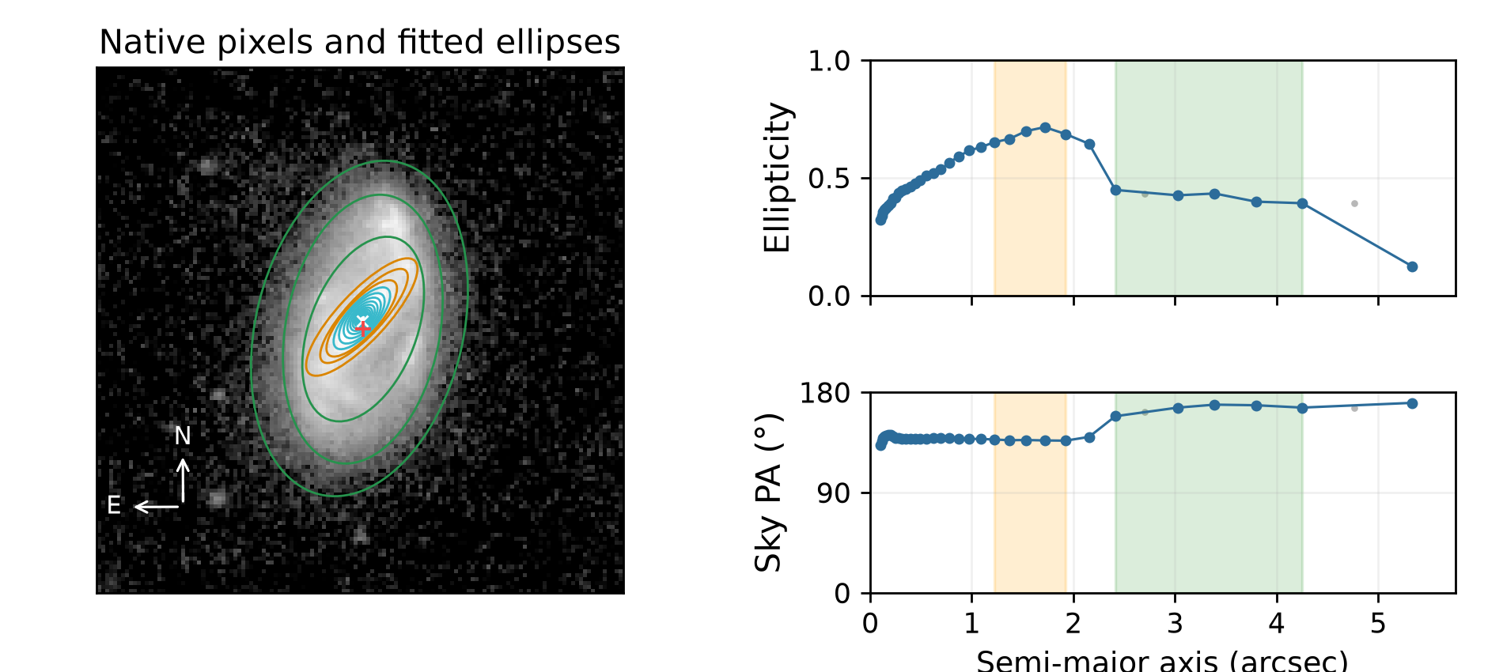
Recovered short-profile failures
These galaxies previously failed; the current pipeline returns provisional geometry.
Galaxy -649179107478547159
Galaxy -559696446492621477
Disc 119.74°; bar 117.80°; i 62.26°
Centre offset 0.39 arcsec; 35 accepted ellipses.
Disc 166.58°; bar 137.17°; i 54.96°
Centre offset 0.21 arcsec; 34 accepted ellipses.
Recovery does not imply an unflagged result. Inspect the selected intervals, centre and method.
14 / 17
Notes:
Sources: verified adaptive v2 MER_VIS_local_geometry_manifest.csv, MER_VIS_v2_summary.json, MER_VIS_report_verification.json. Pipeline version MER_VIS_adaptive_v2_2026-10-20 plus explicit failure-only centre recovery. Raw science images unchanged. PA is North towards East modulo180. All numbers from the current run, not copied from earlier reports. Example records: {"key":"reliable isophotes","title":"Recovered short-profile failures","kind":"recovery","examples":[{"id":"-649179107478547159","image":"C:\\Users\\gordo\\Documents\\Github\\PythonScripts\\Foreground Masking\\MER_VIS_pipeline_v2\\current_report\\images\\-649179107478547159.png","full_card":"D:\\Dropbox\\Public Documents\\UCLAN\\MSc Research\\Euclid\\MER_VIS_galaxy_reports\\all_2777\\png_NoQI\\0841_Euclid_-649179107478547159_MER_VIS_geometry_report.png","disc":119.73884912427816,"bar":117.80356388580608,"inc":62.257451762046315,"centre_offset":0.39132993633287316,"method":"standard","flags":[],"bar_status":"detected_A","error":"","n_good":"35","n_disc":"3","n_bar":"13","disc_scatter":0.9407053648234712,"disc_span":0.029550652106817843,"bar_end":4.117346878027748,"information":""},{"id":"-559696446492621477","image":"C:\\Users\\gordo\\Documents\\Github\\PythonScripts\\Foreground Masking\\MER_VIS_pipeline_v2\\current_report\\images\\-559696446492621477.png","full_card":"D:\\Dropbox\\Public Documents\\UCLAN\\MSc Research\\Euclid\\MER_VIS_galaxy_reports\\all_2777\\png_NoQI\\0254_Euclid_-559696446492621477_MER_VIS_geometry_report.png","disc":166.57918780702744,"bar":137.1747972212369,"inc":54.96439191687562,"centre_offset":0.21219971153547804,"method":"standard","flags":[],"bar_status":"detected_A","error":"","n_good":"34","n_disc":"5","n_bar":"5","disc_scatter":3.7265982343553294,"disc_span":0.05649696673345611,"bar_end":1.923554092877952,"information":""}],"available":135}

Slide 15
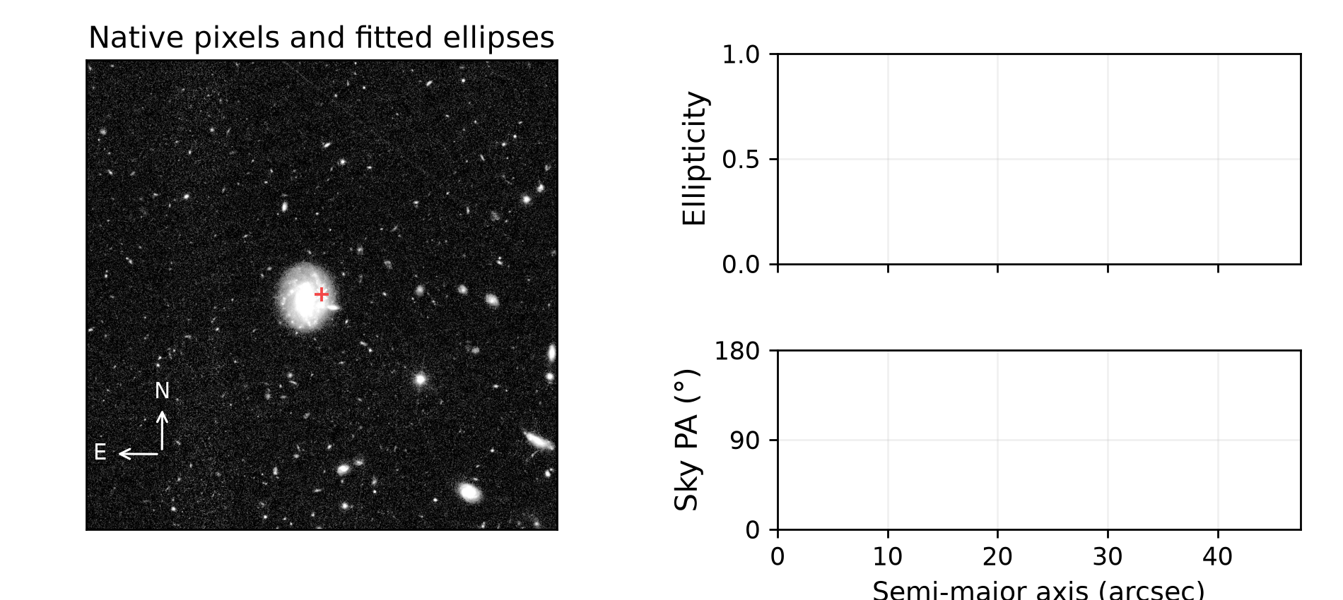
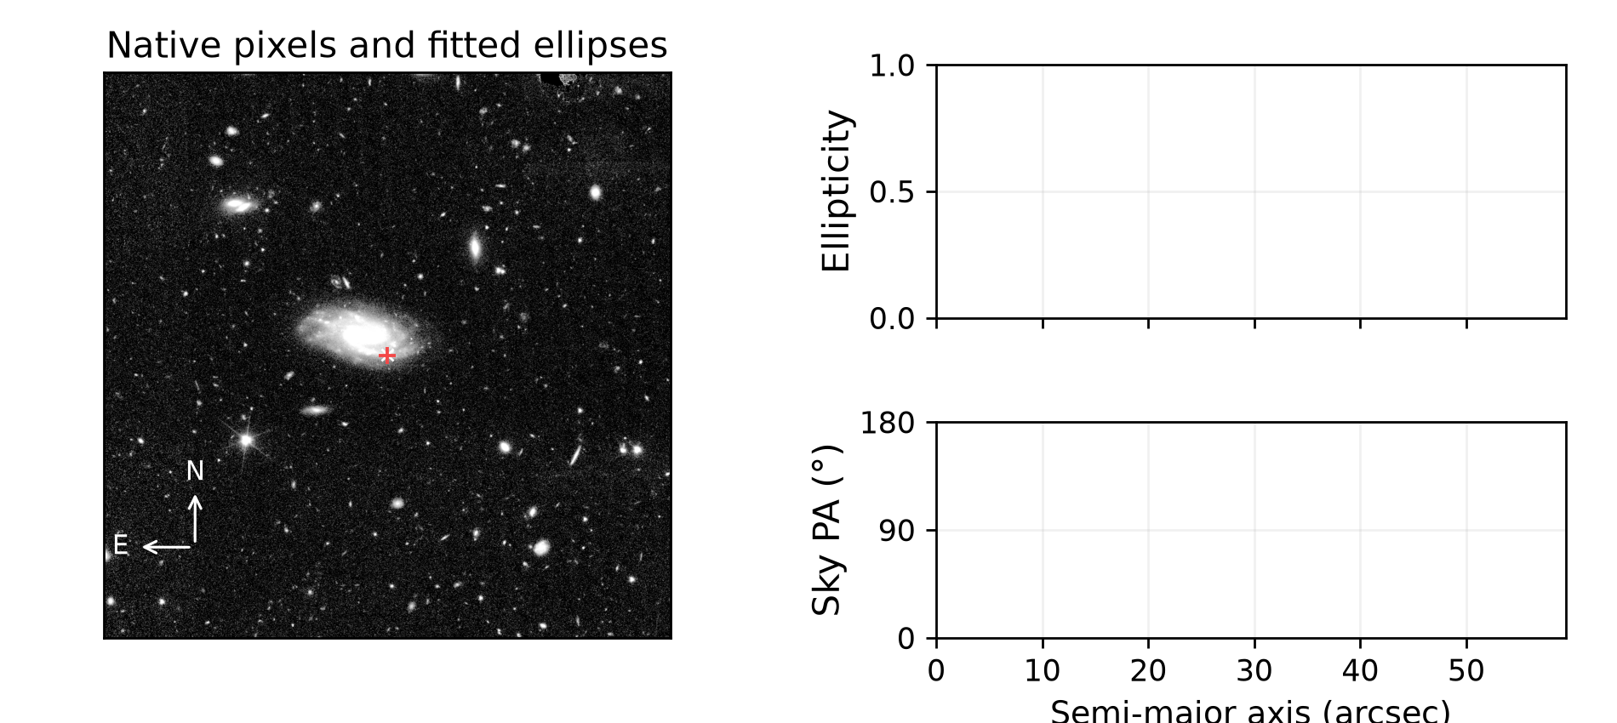
Remaining fit failures
Actual remaining failures. No geometry is invented to fill missing values.
Galaxy -586374330510251740
Galaxy -584896980492699093
Disc unavailable; bar unavailable; i unavailable
Centre offset unavailable arcsec; 0 accepted ellipses.
Disc unavailable; bar unavailable; i unavailable
Centre offset unavailable arcsec; 0 accepted ellipses.
Consult the failure log and the image; remaining objects may require an individual fit.
15 / 17
Notes:
Sources: verified adaptive v2 MER_VIS_local_geometry_manifest.csv, MER_VIS_v2_summary.json, MER_VIS_report_verification.json. Pipeline version MER_VIS_adaptive_v2_2026-10-20 plus explicit failure-only centre recovery. Raw science images unchanged. PA is North towards East modulo180. All numbers from the current run, not copied from earlier reports. Example records: {"key":"failure","title":"Remaining fit failures","kind":"failure","examples":[{"id":"-586374330510251740","image":"C:\\Users\\gordo\\Documents\\Github\\PythonScripts\\Foreground Masking\\MER_VIS_pipeline_v2\\current_report\\images\\-586374330510251740.png","full_card":"D:\\Dropbox\\Public Documents\\UCLAN\\MSc Research\\Euclid\\MER_VIS_galaxy_reports\\all_2777\\png_QI\\0057_Euclid_-586374330510251740_MER_VIS_geometry_report_QI.png","disc":null,"bar":null,"inc":null,"centre_offset":null,"method":"smoothed_relaxed","flags":[],"bar_status":"not_measured","error":"ValueError: Only 0 accepted isophotes after recovery; need at least 3","n_good":"0","n_disc":"","n_bar":"","disc_scatter":null,"disc_span":null,"bar_end":null,"information":""},{"id":"-584896980492699093","image":"C:\\Users\\gordo\\Documents\\Github\\PythonScripts\\Foreground Masking\\MER_VIS_pipeline_v2\\current_report\\images\\-584896980492699093.png","full_card":"D:\\Dropbox\\Public Documents\\UCLAN\\MSc Research\\Euclid\\MER_VIS_galaxy_reports\\all_2777\\png_QI\\0301_Euclid_-584896980492699093_MER_VIS_geometry_report_QI.png","disc":null,"bar":null,"inc":null,"centre_offset":null,"method":"smoothed_relaxed","flags":[],"bar_status":"not_measured","error":"ValueError: Only 0 accepted isophotes after recovery; need at least 3","n_good":"0","n_disc":"","n_bar":"","disc_scatter":null,"disc_span":null,"bar_end":null,"information":""}],"available":6}

Slide 16
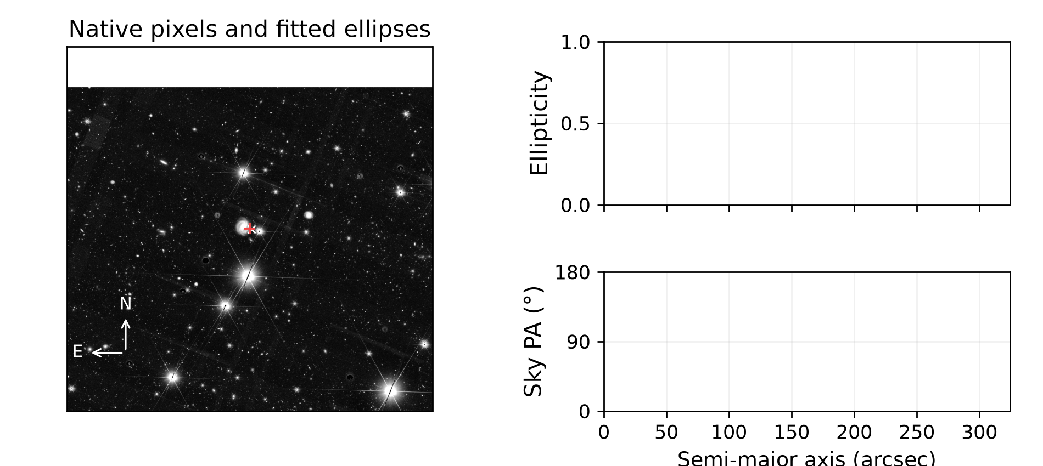
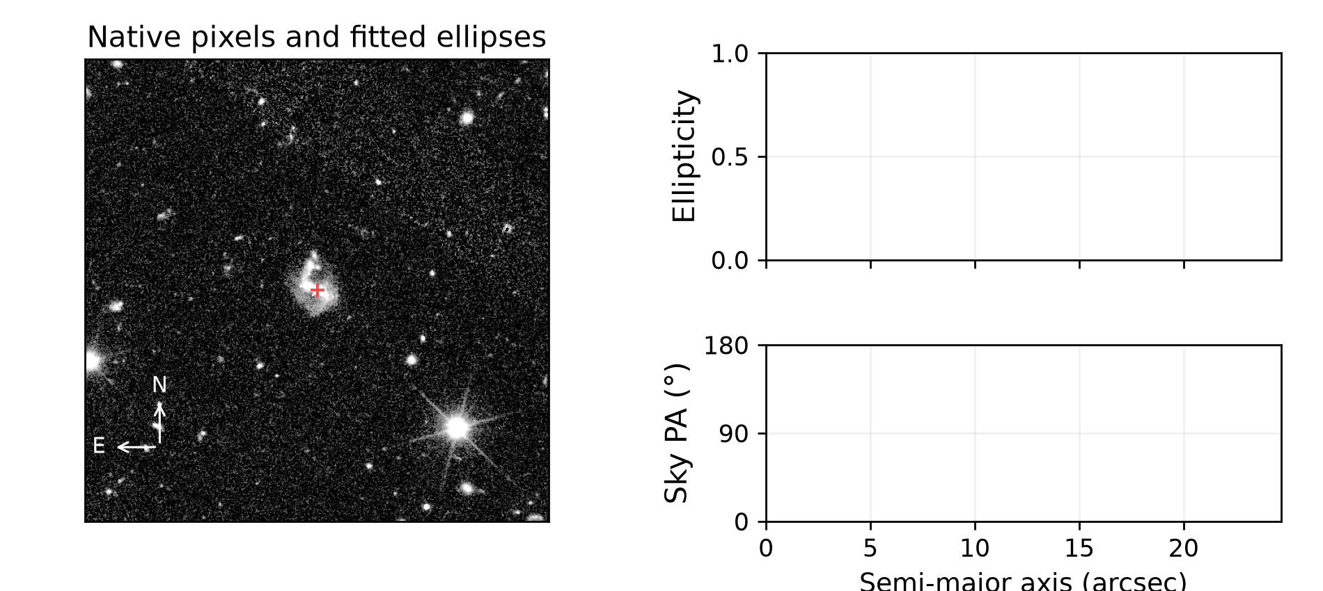
Remaining fit failures
Actual remaining failures. No geometry is invented to fill missing values.
Galaxy -524824554283124036
Galaxy 2645436353651870062
Disc unavailable; bar unavailable; i unavailable
Centre offset unavailable arcsec; 0 accepted ellipses.
Disc unavailable; bar unavailable; i unavailable
Centre offset unavailable arcsec; 0 accepted ellipses.
Consult the failure log and the image; remaining objects may require an individual fit.
16 / 17
Notes:
Sources: verified adaptive v2 MER_VIS_local_geometry_manifest.csv, MER_VIS_v2_summary.json, MER_VIS_report_verification.json. Pipeline version MER_VIS_adaptive_v2_2026-10-20 plus explicit failure-only centre recovery. Raw science images unchanged. PA is North towards East modulo180. All numbers from the current run, not copied from earlier reports. Example records: {"key":"failure","title":"Remaining fit failures","kind":"failure","examples":[{"id":"-524824554283124036","image":"C:\\Users\\gordo\\Documents\\Github\\PythonScripts\\Foreground Masking\\MER_VIS_pipeline_v2\\current_report\\images\\-524824554283124036.png","full_card":"D:\\Dropbox\\Public Documents\\UCLAN\\MSc Research\\Euclid\\MER_VIS_galaxy_reports\\all_2777\\png_QI\\1557_Euclid_-524824554283124036_MER_VIS_geometry_report_QI.png","disc":null,"bar":null,"inc":null,"centre_offset":null,"method":"smoothed_relaxed","flags":[],"bar_status":"not_measured","error":"ValueError: Only 0 accepted isophotes after recovery; need at least 3","n_good":"0","n_disc":"","n_bar":"","disc_scatter":null,"disc_span":null,"bar_end":null,"information":""},{"id":"2645436353651870062","image":"C:\\Users\\gordo\\Documents\\Github\\PythonScripts\\Foreground Masking\\MER_VIS_pipeline_v2\\current_report\\images\\2645436353651870062.png","full_card":"D:\\Dropbox\\Public Documents\\UCLAN\\MSc Research\\Euclid\\MER_VIS_galaxy_reports\\all_2777\\png_QI\\2079_Euclid_2645436353651870062_MER_VIS_geometry_report_QI.png","disc":null,"bar":null,"inc":null,"centre_offset":null,"method":"smoothed_relaxed","flags":[],"bar_status":"not_measured","error":"ValueError: Only 0 accepted isophotes after recovery; need at least 3","n_good":"0","n_disc":"","n_bar":"","disc_scatter":null,"disc_span":null,"bar_end":null,"information":""}],"available":6}

Slide 17
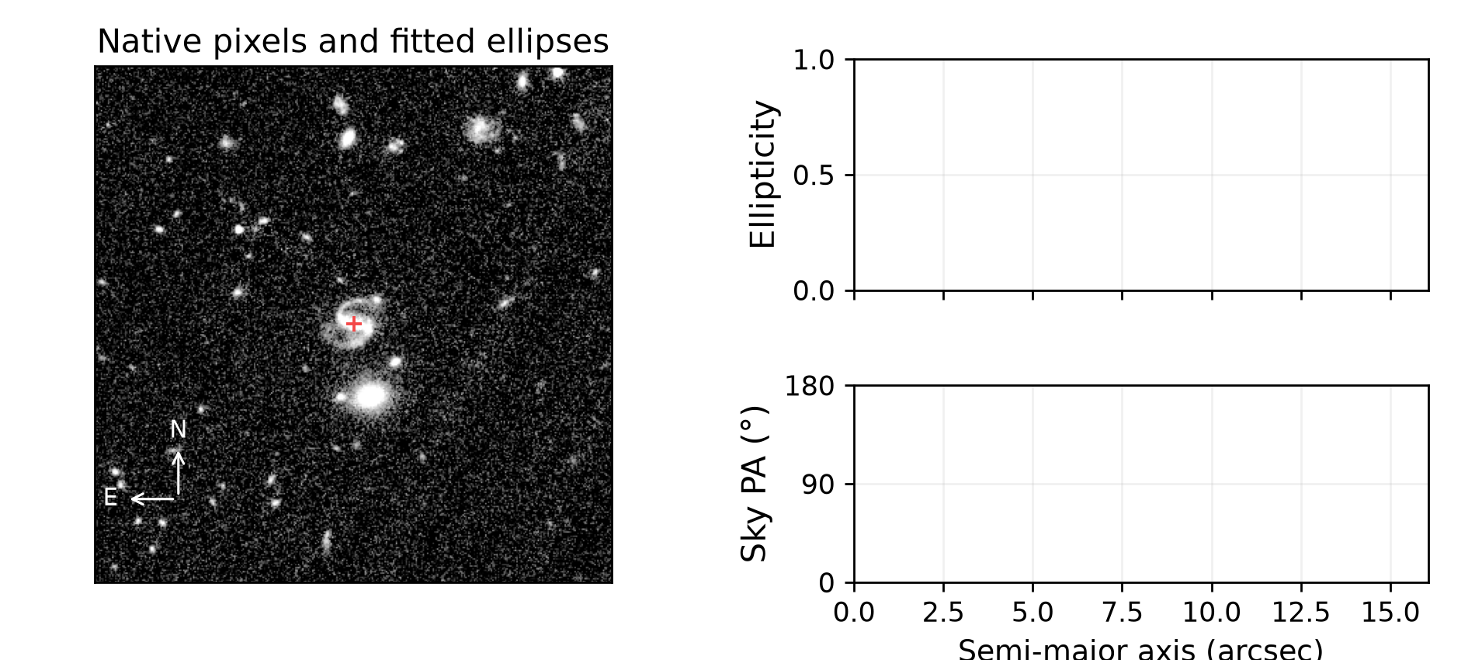
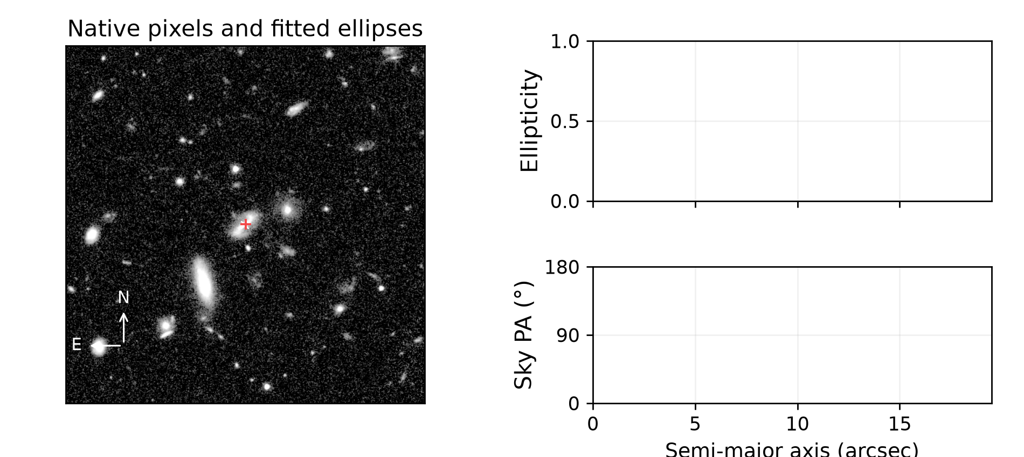
Remaining fit failures
Actual remaining failures. No geometry is invented to fill missing values.
Galaxy 2697242050653408730
Galaxy 2690276161666121755
Disc unavailable; bar unavailable; i unavailable
Centre offset unavailable arcsec; 0 accepted ellipses.
Disc unavailable; bar unavailable; i unavailable
Centre offset unavailable arcsec; 0 accepted ellipses.
Consult the failure log and the image; remaining objects may require an individual fit.
17 / 17
Notes:
Sources: verified adaptive v2 MER_VIS_local_geometry_manifest.csv, MER_VIS_v2_summary.json, MER_VIS_report_verification.json. Pipeline version MER_VIS_adaptive_v2_2026-10-20 plus explicit failure-only centre recovery. Raw science images unchanged. PA is North towards East modulo180. All numbers from the current run, not copied from earlier reports. Example records: {"key":"failure","title":"Remaining fit failures","kind":"failure","examples":[{"id":"2697242050653408730","image":"C:\\Users\\gordo\\Documents\\Github\\PythonScripts\\Foreground Masking\\MER_VIS_pipeline_v2\\current_report\\images\\2697242050653408730.png","full_card":"D:\\Dropbox\\Public Documents\\UCLAN\\MSc Research\\Euclid\\MER_VIS_galaxy_reports\\all_2777\\png_QI\\2221_Euclid_2697242050653408730_MER_VIS_geometry_report_QI.png","disc":null,"bar":null,"inc":null,"centre_offset":null,"method":"smoothed_relaxed","flags":[],"bar_status":"not_measured","error":"ValueError: Only 0 accepted isophotes after recovery; need at least 3","n_good":"0","n_disc":"","n_bar":"","disc_scatter":null,"disc_span":null,"bar_end":null,"information":""},{"id":"2690276161666121755","image":"C:\\Users\\gordo\\Documents\\Github\\PythonScripts\\Foreground Masking\\MER_VIS_pipeline_v2\\current_report\\images\\2690276161666121755.png","full_card":"D:\\Dropbox\\Public Documents\\UCLAN\\MSc Research\\Euclid\\MER_VIS_galaxy_reports\\all_2777\\png_QI\\2444_Euclid_2690276161666121755_MER_VIS_geometry_report_QI.png","disc":null,"bar":null,"inc":null,"centre_offset":null,"method":"smoothed_relaxed","flags":[],"bar_status":"not_measured","error":"ValueError: Only 0 accepted isophotes after recovery; need at least 3","n_good":"0","n_disc":"","n_bar":"","disc_scatter":null,"disc_span":null,"bar_end":null,"information":""}],"available":6}

